Slide 1
Loops
Slides by Varick and Ashley Erickson
© Varick Erickson

Slide 2
Questions before we continue?
Next: Loops

Slide 3
Some loop terms to know
Loop: code that repeats under specified conditions
Counter: a variable that is incremented or decremented each time a loop repeats. Can be used to control execution of the loop
Note: Must be initialized before entering loop
Running total: accumulated sum of numbers from each repetition of a loop
Accumulator: variable that holds the running total of loop runs

Slide 4
Types of loops in C++
C++ has several types of loops:
Loop type | Definition | When you would use it
while | The loop repeats while the Boolean expression in parenthesis is true. | When you aren’t sure if your loop needs to run at all
do-while | A while loop which is guaranteed to run at least one time. | If you always need the loop to run at least one iteration.
for | (special case of while loop) | When you know how many times your loop should run

Slide 5
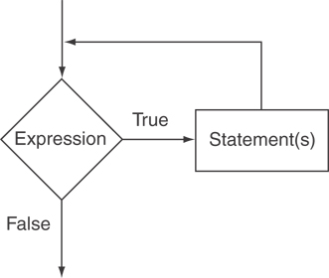
How a while loop works
Check whether the Boolean condition is true
If the Boolean condition is false, the loop doesn’t run
If the Boolean condition is true, the loop runs until the Boolean condition becomes false.
Syntax:
while (boolean expression is true) { statements to repeat }

Slide 6
Example of a while loop
#include <iostream>
using namespace std;
int main() {
int countDown;
cout << "How many greetings do you want?\n";
cin >> countDown;
while (countDown > 0) {
cout << "Hello ";
countDown = countDown - 1;
}
cout << endl;
cout << "That's all!\n";
return 0;
}
Key takeaways:
While loop syntax is similar to if/else.
Put the statements you want to repeat in the braces.
You do not put a semicolon after the while statement!
Semicolons are only used in the statements inside the loop.

Slide 7
Codey sense question
int main() {
int x = 1;
while (x != 12) {
cout << x << endl;
x = x + 2;
}
return 0;
}
What will this loop do?
Print odd numbers less than 12
Print odd numbers continuously
It will not compile since it doesn’t stop
It will not compile since x is not equal to 12
None of these

Slide 8
Infinite Loops
Loops that never stop are called infinite loops
The loop body should contain a line that will eventually cause the Boolean expression to become false
Example: Print the odd numbers less than 12
Better to use this comparison: while ( x < 12).
If you use while (x !=12), the loop will never stop!
int main() {
int x = 1;
while (x != 12) {
cout << x << endl;
x = x + 2;
}
return 0;
}

Slide 9
Questions on while loops?
Next: do-while loops

Slide 10
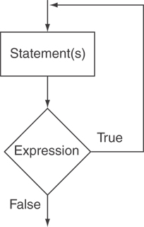
How a do-while loop works
First execute the loop
Then test the expression
Note: A semicolon is required after the expression
A do-while loop is always executed at least once.
do
{
statement;
} while (expression);

Slide 11
Example of a do while loop
#include <iostream>
using namespace std;
int main()
{
char ans;
do
{
cout << "Hello!\n";
cout << "Do you want another greeting?\n"
<< "Press y for yes, n for no,\n"
<< "and then press return: ";
cin >> ans;
} while (ans == 'y' || ans == 'Y’);
cout << "Good-Bye\n";
return 0;
}
This loop is guaranteed to run at least one time.

Slide 12
Any questions before we move on?
Next topic: for loops

Slide 13
How a for loop works
for(initialization; test; update)
statement; // or block in { }
Perform initialization
Evaluate test expression
If true, execute statement
If false, terminate loop execution
Execute update, then re-evaluate test expression

Slide 14
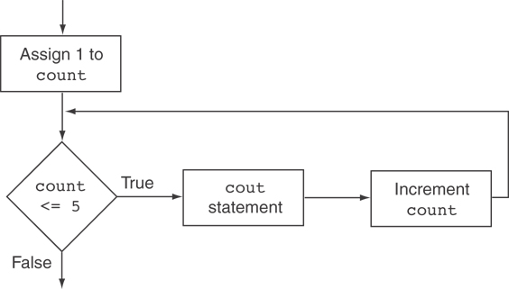
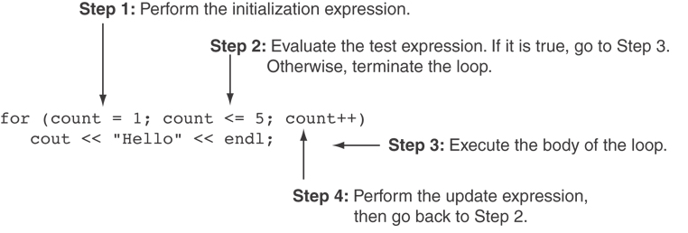
for Loop - Example
#include <iostream>
using namespace std;
int main()
{
int count;
for (count = 1; count <= 5; count++)
cout << "Hello" << endl;
return 0;
}

Slide 15
Codey sense question
Does it matter whether we declare the counting variable inside or outside the for loop?
for (int count = 1; count <= 5; count++)
cout << "Hello" << endl;
count declared as part of the for statement
count declared before the for statement
int count;
for (count = 1; count <= 5; count++)
cout << "Hello" << endl;

Slide 16
When would you want to declare the counting variable in the loop vs. outside?
If you only need the counting variable within the loop, you can declare it as part of the loop initialization
If you need the number of times the loop ran for something else in your program, then you need to declare the variable outside of the loop
for (int count = 1; count <= 5; count++)
cout << "Hello" << endl;
int count;
for (count = 1; count <= 5; count++)
cout << "Hello" << endl;

Slide 17
More on variable scope, blocks
Scope refers to the section of code where a variable is valid.
A block is a section of code enclosed by braces
Very Important rules!
If you declare a variable inside a set of braces, that variable is considered “local” to the braces and will only exist inside the braces!
If you declare a variable inside a for loop statement, that variable is considered “local” to the loop and will only exist in the for loop!
for (int count = 1; count <= 5; count++)
cout << "Hello" << endl;
Here, the count variable is local to the for loop and will not exist once the loop ends! If you need access to count after the loop ends, declare it prior to the for loop statement.

Slide 18
For loops – additional notes
You can have one or more statements in the initialization expression. Separate the statements with a comma. int x, y; for (x=1, y=1; x <= 5; x++) { cout << x << " plus " << y << " equals " << (x+y) << endl; }
Initialization Expression
Can omit the initialization expression if already done:
int sum = 0, num = 1;
for (; num <= 10; num++)
sum += num;

Slide 19
For loops – additional notes
You can also have multiple statements in the test expression. Separate the statements with a comma: int x, y; for (x=1, y=1; x <= 5; x++, y++) { cout << x << " plus " << y << " equals " << (x+y) << endl; }
Test Expression

Slide 20
Questions before we continue?
Next: important notes about increment/decrement operators

Slide 21
More on Increment/Decrements
Often, we use ++ and -- in loops
++ increment operator: adds 1 (count++)
-- decrement operator: subtracts 1 (count--)
When followed by a semicolon, the increment operator becomes a statement:
countdown++;

Slide 22
Note: there are two versions (prefix and post-fix)
int val = 12;
cout << val++; // displays 12
// but val is now 13 (post-fix)
cout << ++val; // displays 14
// val is now 14 (pre-fix)

Slide 23
Questions before we continue?
Next topic: FizzBuzz

Slide 24
The FizzBuzz interview question
The FizzBuzz question:
Many possible approaches.
Every developer should pass this simple test.
Helps you to understand the programming style and approach of the candidate.
How does he/she work under pressure?
Does he/she care about maintainability? Clean code? Scalability?

Slide 25
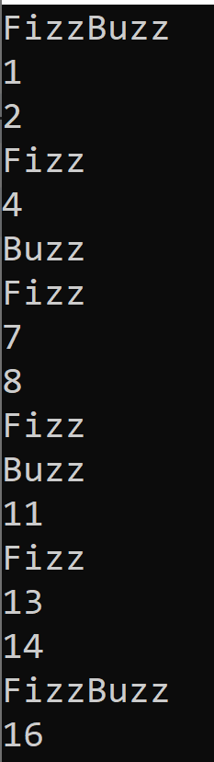
The Fizz Buzz question
Write a program that prints the numbers from 0 to 100, with the following conditions:
For multiples of three, print “Fizz” instead of the number
For multiples of five, print “Buzz” instead of the number.
For multiples of both three and five, print “FizzBuzz”
Sample output shown on right:

Slide 26
Brute force approach
Use a for loop with if statements to check every possible case.
int main()
{
for (int i = 0; i < 100; i++)
{
if (i % 3 != 0 && i % 5 != 0)
cout << i << endl;
else if (i % 3 == 0 && i % 5 != 0)
cout << "Fizz\n";
else if (i % 3 != 0 && i % 5 == 0)
cout << "Buzz\n";
else
cout << "FizzBuzz\n";
}
return 0;
}
Notes:
Example in repository shows brute force.
Can walk through better approach

Slide 27
More about the brute force approach
This program is a correct way to do FizzBuzz.
But it requires a lot of code
If someone asked you to also output “Bang” when you have a multiple of seven, this program would be a huge pain to modify!

Slide 28
Clever approach
Use if statements to check for each required condition
int main()
{
for (int i = 0; i < 100; i++)
{
if (i % 3 != 0 && i % 5 != 0)
cout << i;
if (i % 3 == 0)
cout << "Fizz";
if (i % 5 == 0)
cout << "Buzz";
cout << endl;
}
return 0;
}

Slide 29
More about the clever approach
More elegant solution
Shows understanding of if statements and formatting
Makes it MUCH easier to add more conditions or make changes to the requirements.

